Slide 1

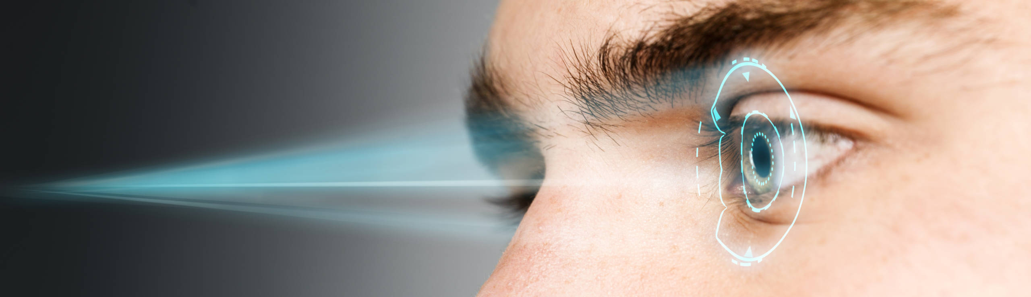
Retinal/Iris scanners
Max Meiners

Slide 2
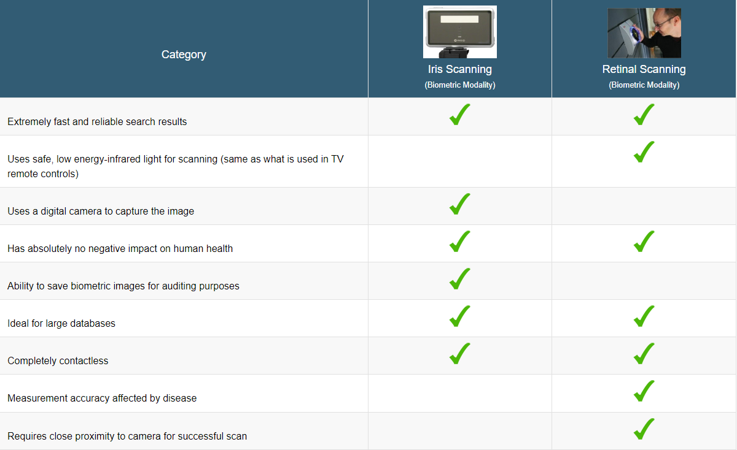
Differences & similarities

Slide 3
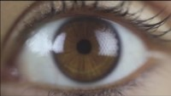

Slide 4
Topics
Minority Report vs. Real-life setting
01
Feasibility
03
Taxonomy of AI
02
Sources
04

Slide 5

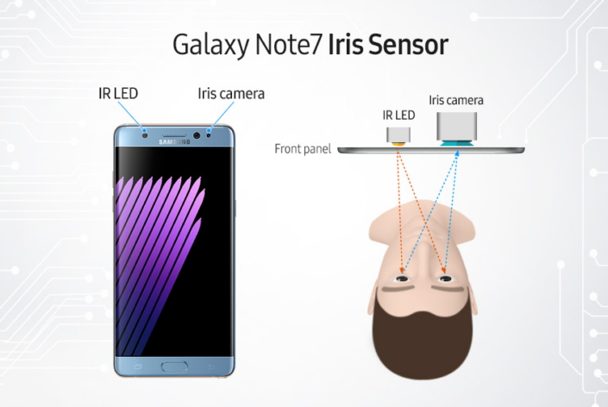

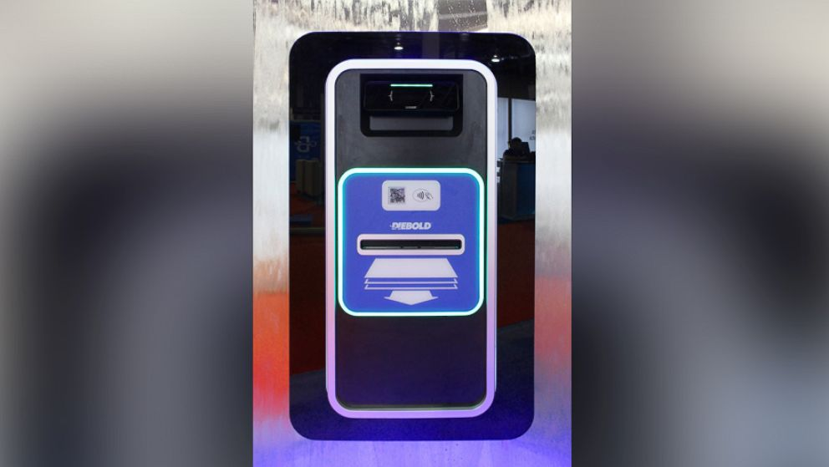
Minority report VS real-life setting

Slide 6
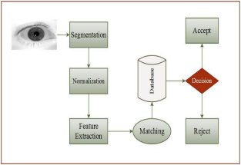
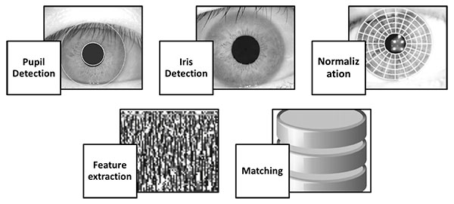
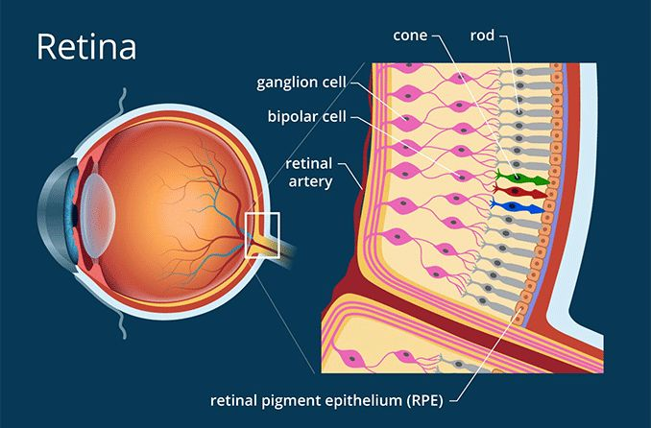
Taxonomy of AI
Domain | Sub-domain
Perception | Computer vision

Slide 7
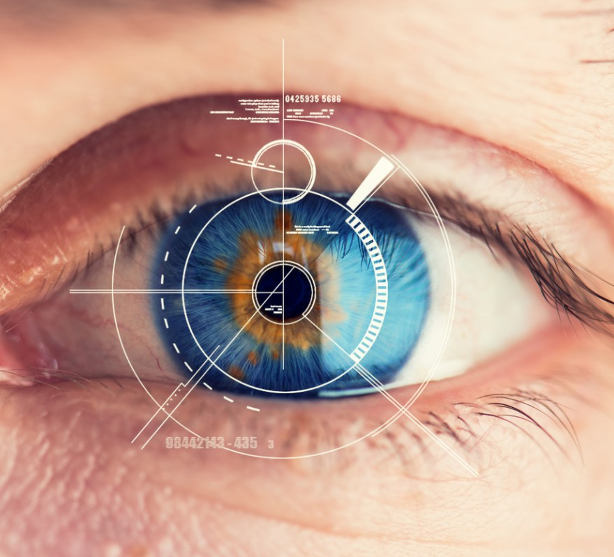
Feasibility

Slide 8
Sources
Wikipedia contributors. (2022, 13 februari). Retinal scan. Wikipedia. Geraadpleegd op 21 september 2022, van https://en.wikipedia.org/wiki/Retinal_scan
Aarons, A. (2017, 21 november). What Are the Dangers of Retinal Scanners? Small Business - Chron.com. Geraadpleegd op 21 september 2022, van https://smallbusiness.chron.com/dangers-retinal-scanners-70631.html
Public Iris Scanner by Steven Spielberg from Minority Report (Movie). (z.d.). Geraadpleegd op 21 september 2022, van http://www.technovelgy.com/ct/content.asp?Bnum=1213
Kim, S. (2015, 26 oktober). ATMs That Scan Your Eyeballs for Cash Being Tested in U.S. ABC News. Geraadpleegd op 21 september 2022, van https://abcnews.go.com/Business/atms-scan-eyeballs-cash-tested-us/story?id=34741159
Ghali, A. A. (2017, 30 november). A Review of Iris Recognition Algorithms | Ghali | JOIV : International Journal on Informatics Visualization. Geraadpleegd op 21 september 2022, van https://joiv.org/index.php/joiv/article/view/62/65
Wikipedia contributors. (2022b, september 5). Digital image processing. Wikipedia. Geraadpleegd op 22 september 2022, van https://en.wikipedia.org/wiki/Digital_image_processing
undefined [CNN]. (2015, 4 september). Iris eye scanners getting longer range. YouTube. Geraadpleegd op 23 september 2022, van https://www.youtube.com/watch?v=H3WnjrccQ_I&ab_channel=CNN
Just a moment. . . (z.d.-d). Geraadpleegd op 23 september 2022, van https://www.researchgate.net/profile/Oludare-Omolara/publication/333538332_Fingereye_improvising_security_and_optimizing_ATM_transaction_time_based_on_iris-scan_authentication/links/5d0521b692851c90043f0473/Fingereye-improvising-security-and-optimizing-ATM-transaction-time-based-on-iris-scan-authentication.pdf

